Slide 1


Super Shop Sales Prediction
Course Title: Machine Learning Lab
Subbmitted By
Subbmitted To
Md. Riad Hassan
Lecturer, CSE
Sabbir Ahmed 221002398
Monowar Hossen Sourov 221002578
1

Slide 2






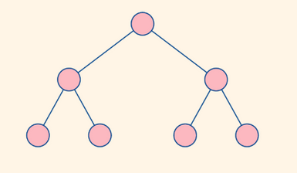

Working Flow
Data
Data Pre-processing
Data Analysis
Data Evaluation
XGBoost Regressor
Model
Data Train Test Split
2

Slide 3
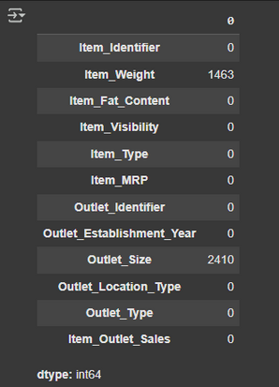
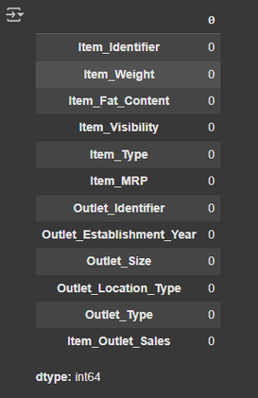
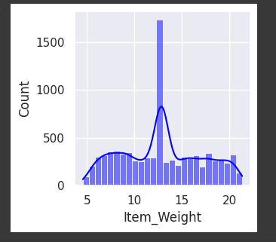
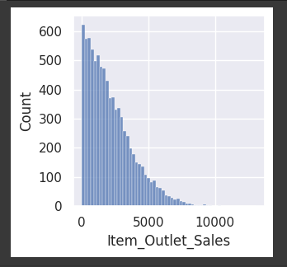
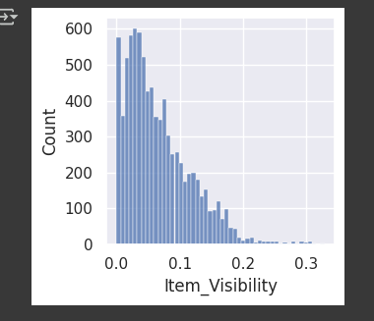
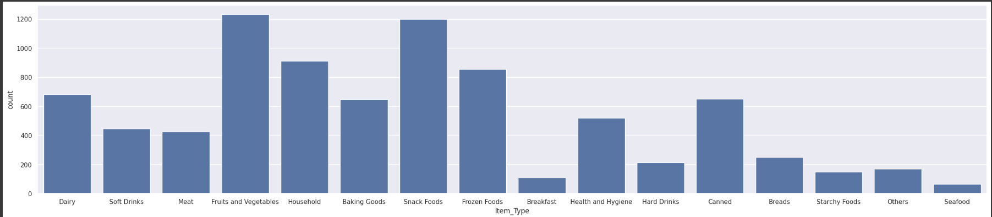
Data Cleaning & Visualization
Visibility distribution
Find Mising Value
After HnadaleMising Value
3
Visibility distribution For All item

Slide 4
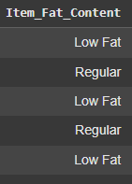
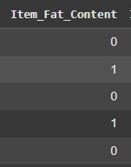
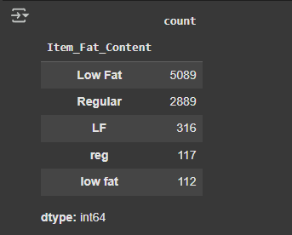
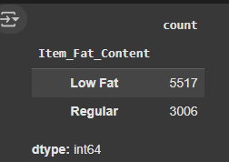

Data Preprocessing
& splitting
Mixed values
Cleaned values
Before Label
After Label
Train-Test Split Output
4

Slide 5

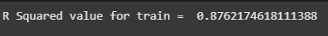
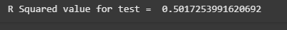
Model And Evaluation
Train Data Acuuracy
XGBRegressor
Test Data Acuuracy
5

